Slide 1
Social insurance in Poland in the context of population ageing
Social Protection Reform Project
Component 1: Study Visit, Spain, Czech Republic and Poland, Oct.-Nov. 2015

Slide 2
Demographic constraints
 | 2013 | 2020 | 2030 | 2040 | 2050 | 2060
Population | 38 353 | 38 343 | 37 362 | 35 886 | 34 292 | 32 390
Pre working age | 6 998 | 7 037 | 6 203 | 5 282 | 5 151 | 4 741
Working age | 24 217 | 22 696 | 21 525 | 19 931 | 17 118 | 15 477
Post working age* | 7 138 | 8 611 | 9 634 | 10 672 | 12 022 | 12 172
*Post working age – 65+
Source: EUROSTAT demographic forecast
Social Protection Reform Project
Component 1: Study Visit, Spain, Czech Republic and Poland, Oct.-Nov. 2015

Slide 3
Share of economic groups in population
 | 2013 | 2020 | 2030 | 2040 | 2050 | 2060
Population in:
Pre working age | 18,2 % | 18,4 % | 16,6 % | 14,7 % | 15,0 % | 14,6 %
Working age | 63,1 % | 59,2 % | 57,6 % | 55,5 % | 49,9 % | 47,8 %
Post working age | 18,6 % | 22,5 % | 25,8 % | 29,7 % | 35,1 % | 37,6 %
*Post working age – 65+
Social Protection Reform Project
Component 1: Study Visit, Spain, Czech Republic and Poland, Oct.-Nov. 2015

Slide 4
Raising of retirement age
started on 1.01.2013
from the level of 60 years for women and 65 for men
increase 3 months per year
age of 67 will be achieved in 2020 for men and 2040 for women
expected increase of future benefits
Social Protection Reform Project
Component 1: Study Visit, Spain, Czech Republic and Poland, Oct.-Nov. 2015

Slide 5
Share of economic groups in population
 | 2013 | 2020 | 2030 | 2040 | 2050 | 2060
Population in:
Pre working age | 18,2% | 18,4% | 16,6% | 14,7% | 15,0% | 14,6%
Working age | 63,3% (+0,2%) | 61,8% (+2,6%) | 61,3% (+3,7%) | 62,4% (+6,9%) | 57,1% (+7,2%) | 53,1% (+5,3%)
Post working age* | 18,4% | 19,8% | 22,1% | 22,9% | 27,8% | 32,3%
*Post working age – 67+
Social Protection Reform Project
Component 1: Study Visit, Spain, Czech Republic and Poland, Oct.-Nov. 2015

Slide 6
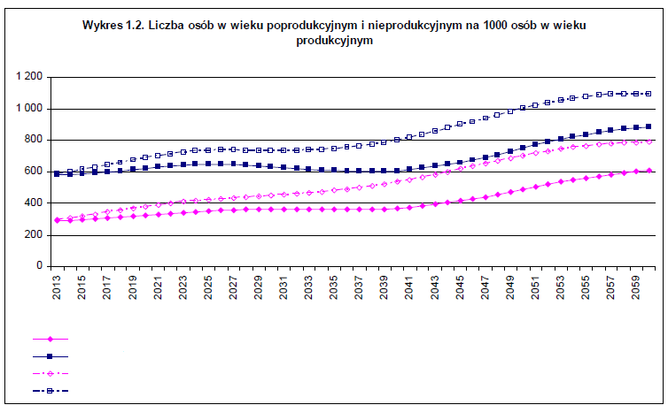
Demographic dependancy
No of post working age and non working age persons in relation to 1000 persons in working age
Post working age – after raising retirement age
Non working age – after raising retirement age
Post working age – before raising retirement age
Non working age – before raising retirement age
Social Protection Reform Project
Component 1: Study Visit, Spain, Czech Republic and Poland, Oct.-Nov. 2015

Slide 7
Forecast of Social Insurance Fund
3 scenarios analised: realistic, pesimistic and optimistic
Difference in assumptions as regards coverage of social insurance and likelihood of disability
Common assumptions as regards indexation of benefits and macroeconomic conditions
Social Protection Reform Project
Component 1: Study Visit, Spain, Czech Republic and Poland, Oct.-Nov. 2015

Slide 8
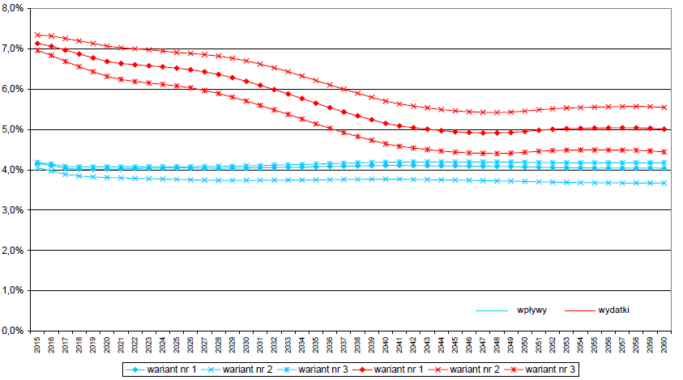
Yearly balance of old-age pension fund as a share of GDP
inflow
exp.
Social Protection Reform Project
Component 1: Study Visit, Spain, Czech Republic and Poland, Oct.-Nov. 2015

Slide 9
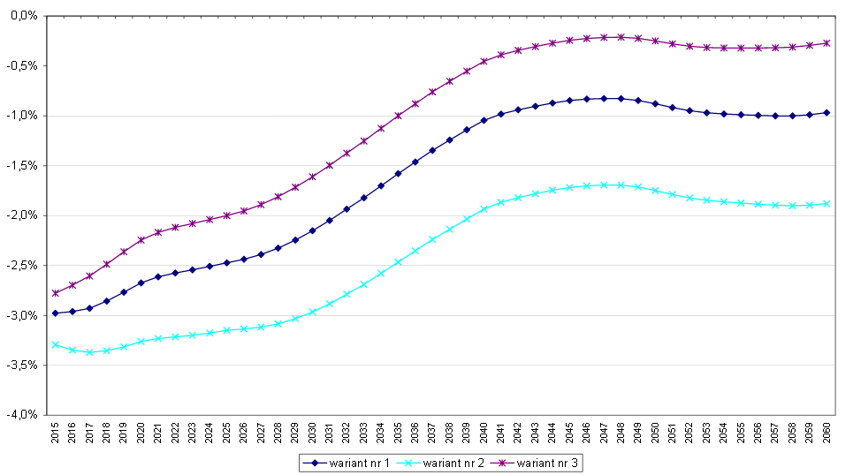
Yearly balance of old-age pension fund as a share of GDP
Social Protection Reform Project
Component 1: Study Visit, Spain, Czech Republic and Poland, Oct.-Nov. 2015

Slide 10
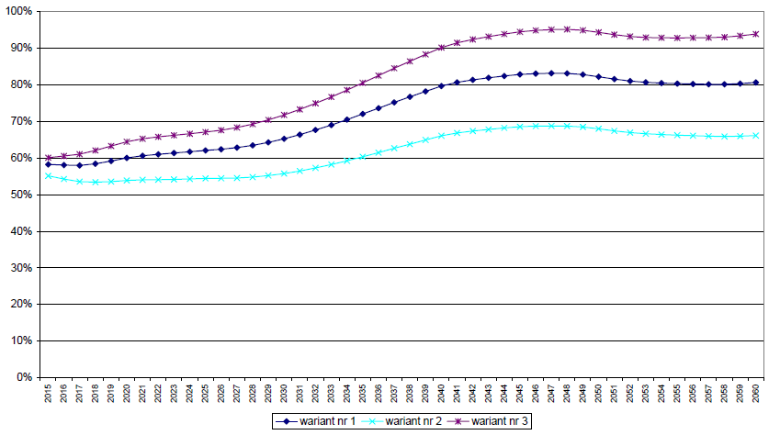
Efficiency of old-age pension system
Social Protection Reform Project
Component 1: Study Visit, Spain, Czech Republic and Poland, Oct.-Nov. 2015

Slide 11
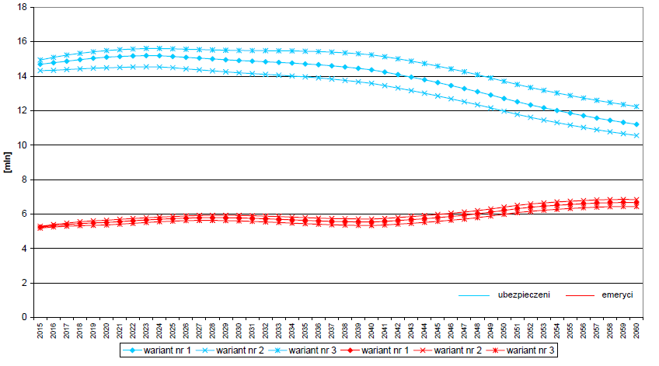
Numbers of insured and recipients of old-age pensions
insured
ben.
Social Protection Reform Project
Component 1: Study Visit, Spain, Czech Republic and Poland, Oct.-Nov. 2015

Slide 12
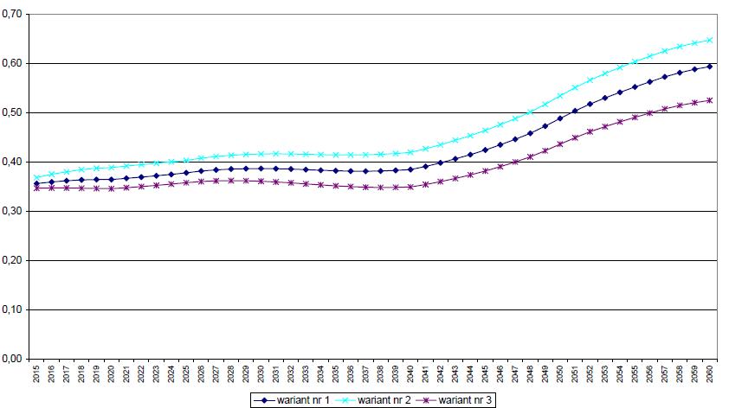
System dependancy ratio
Social Protection Reform Project
Component 1: Study Visit, Spain, Czech Republic and Poland, Oct.-Nov. 2015

Slide 13
Raising of retirement age in the context of ageing
Improves the financial situation of old-age pension fund
Increases the share of economically active persons in population
Social Protection Reform Project
Component 1: Study Visit, Spain, Czech Republic and Poland, Oct.-Nov. 2015

Slide 14
Thank you for your attention
Social Protection Reform Project
Component 1: Study Visit, Spain, Czech Republic and Poland, Oct.-Nov. 2015

