Slide 1
EU-China Social Protection Reform Project
Rome, 27 May 2019
The future of
Social protection:
What works for
non-standard workers
Veerle MIRANDA
Twitter: @OECD_Social

Slide 2
Non-standard employment is not a marginal phenomenon
Source: OECD Employment Outlook 2019

Slide 3
Non-standard employment is not a marginal phenomenon
Platform work accounts for 0.5-3% of the labour force
Source: OECD Employment Outlook 2019

Slide 4
Statutory access to social protection for independent workers if often limited
 | Not applicable | No access | Voluntary/ partial access | Same as employees
Maternity and family benefits | USA | KOR | GRC ITA POL CZE NLD FRA DEU EST CAN PRT GBR JPN | TUR ESP BEL LTU HUN AUS NOR LUX ISL SVN FIN AUT SWE IRL LVA DNK SVK CHE
Unemployment benefits |  | TUR ITA NLD CHE FRA LTU LVA JPN CAN NOR USA | GRC KOR POL ESP IRL BEL AUT DEU DNK GBR FIN SWE EST | PRT CEZ SVK SVN HUN AUS
 | Only voluntary | Voluntary at low earnings | Partial | Similar to employees
Old-age pensions | DEU | ITA PRT SVK NOR LUX GBR | MEX CHL POL NLD CHE LTU LVA DNK AUS ESP IRL AUT JPN | GRC TUR KOR NZL CZE BEL FIN ISR HUN CAN USA ISL SVN FRA SWE

Slide 5
How much support is available in practice?
Source: OECD Employment Outlook 2019

Slide 6
How much support is available in practice?
Source: OECD Employment Outlook 2019

Slide 7
Key policy issues for addressing social protection gaps
Some economic activities do not give rise to social protection entitlements
Past employment duration or social contributions are insufficient to qualify for benefits
Non-standard workers are treated differently during the claiming process
Already acquired entitlements are lost during a change in employment status or job

Slide 8
Key policy issues for addressing social protection gaps
Some economic activities do not give rise to social protection entitlements
Tie entitlements to individual workers
or
Untie benefits from contributions
Past employment duration or social contributions are insufficient to qualify for benefits
Non-standard workers are treated differently during the claiming process
Already acquired entitlements are lost during a change in employment status or job

Slide 9
Individualisation of social protection
Tying social protection entitlements to individuals, not employment relationships
Preserves entitlements during job changes and career breaks
Austria: individual pension accounts
Earnings from different sources can be combined and funds can be used for different ends
No risk sharing and no redistribution

Slide 10
Making social protection more universal
Blurred lines between traditional employment and different forms of independent work
Loosen the link between employment and entitlements
Basic income is costly and often not effective against poverty
Strengthen minimum income safety nets
No significant income smoothing
Possibility of crowding out employer contributions

Slide 11
Voluntary protection for non-standard workers
Several countries opt for voluntary schemes to extend social security coverage to non-standard workers
Risk of adverse selection (Sweden, Canada & Austria)
High coverage is needed to make voluntary insurance viable
Low willingness to pay
Substantial public subsidies are necessary

Slide 12
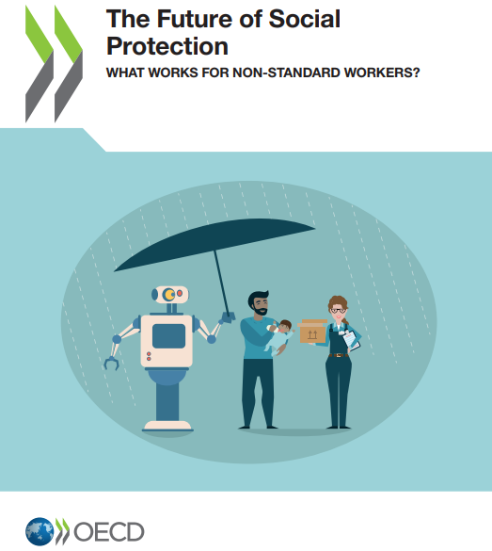
Closing words
“Future technological and labour market developments are uncertain. But it can be no excuse for delaying reforms that are needed to make social protection ready for the future.”
Contact: Veerle Miranda (Veerle.MIRANDA@oecd.org)

