Slide 1
Czech Labour Market
and
Employment of Foreigners
Prague 27 Oct. 2016
Ministry of Labour and Social Affairs
1

Slide 2
MOLSA – Unit for International Employment
Foreign employment policy: Cooperation in developing principles and objectives of the policy;
Records and statistics: administration of the central register of vacancies intended for Employment Cards and Blue Cards holders;
Interministerial cooperation: migration projects Fast track, Welcome Package; illegal employment tackling;
Integration of foreigners: www.cizinci.cz;
International cooperation: EU institutions (EMCO); european directives; OECD; ILO
2

Slide 3
Situation on the Czech Labour Market
Number of inhabitants: 10 262 040
Economically activ people: cca 59 %
Foreigners living in CZ 470 000
Situation on 30. 09. 2016
Number of jobseekers : 378 258
Unemployment rate: 5.2 %
Number of vacancies: 140 993
Jobseekers per 1 vacancy: 2.7
Foreigners employed
in the Czech Republic (30.06.2016) 350 075
3

Slide 5
Number of foreigners employed in CZ 1/2
Year | Total |  |  |  | China
 |  | EU citizens | 3 countries |  | Total | Permission to work*/ | Information card
2004 | 107 984 | 72 840 | 35 144 |  | 322 | 313 | 9
2005 | 151 736 | 93 867 | 57 869 |  | 935 | 891 | 44
2006 | 185 075 | 116 846 | 68 229 |  | 876 | 798 | 78
2007 | 240 242 | 144 751 | 95 491 |  | 1 074 | 973 | 101
2008 | 284 551 | 141 101 | 143 450 |  | 1 555 | 1414 | 141
2009 | 230 709 | 139 315 | 91 394 |  | 1 356 | 1166 | 190
2010 | 215 367 | 143 997 | 71 370 |  | 1 121 | 783 | 338
2011 | 217 862 | 154 560 | 63 302 |  | 1 317 | 693 | 624
*/ includes: Work Permit, Green Card (from 2009), Blue Card (from 2011) and Employee Card (from 2014)

Slide 6
Number of foreigners employed in CZ */ 2/2
Year | Total |  |  |  | China
 |  | EU citizens | 3 countries |  | Total | Permission to work**/ | Information card
2012 | 221 944 | 158 195 | 63 749 |  | 1 322 | * | *
2013 | 224 284 | 159 880 | 64 404 |  | 1 336 | * | *
2014 | 260 999 | 196 345 | 64 654 |  | 1 639 | 403 | 1 236
2015 | 323 244 | 245 333 | 77 911 |  | 1 914 | 314 | 1 600
30.6. 2016 | 350 075 | 260 545 | 89 530 |  | 2 085 | 346 | 1 739
^{*/ qualified estimations}
**/ includes: Work Permit, Green Card (from 2009), Blue Card (from 2011) and Employee Card (from 2014)

Slide 7
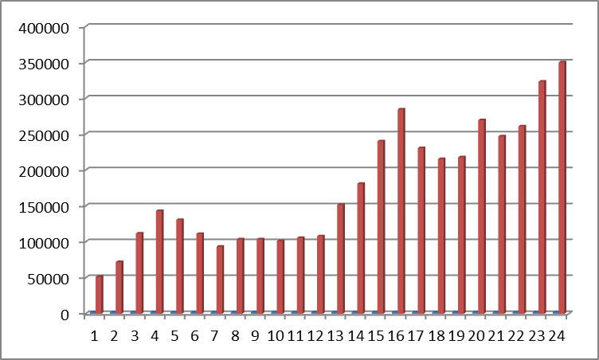
Employment of Foreigners statistics 1/3

Slide 8
Employment of Foreigners statistics 2/3
 | 2012 | 2013 | 2014 | 2015 | 2016 (30.6.)
Infocards EU/EHP a CH | 198 331 | 184 513 | 196 345 | 245 333 | 260 545
Infocards 3rd CN | 41 852 | 38 789 | 43 905 | 61 060 | 67 616
Work Permit | 29 211 | 23 662 | 20 075 | 7 380 | 9 895
Green Cards | 148 | 415 | 226 | 109 | 74
Blue Cards | 4 | 92 | 197 | 224 | 246
Employee Cards | - | - | 251 | 9 138 | 11 699
Total | 217 862 | 269 901 | 260 999 | 323 244 | 350 075
8

Slide 9
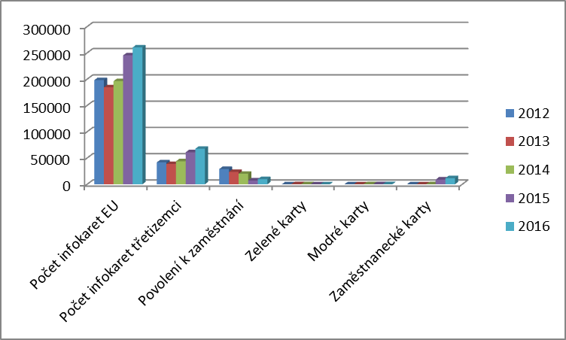
Employment of Foreigners statistics 3/3
9

Slide 10
Employment of foreigners- most important laws
Conditions for employment of foreign citizens
regulated by Act No. 435/2004 Coll., on Employment
Relations between the employee and the employer
regulated by Act No. 262/2006 Coll., the Labour Code
Conditions of residence in the Czech Republic
regulated by Act No. 326/1999 Coll., Residence of foreigners in the Czech Republic

Slide 11
Basic principles
EU/EEA and Switzerland citizens, their family members (3 CN) are not considered as foreigners
→ FREE ACCESS to the labour market
Process:
Information Card
Third country nationals = must be holders of a permission to work:
Employee Card
Blue Crad
Work Permit + Residency Permit (non-dual mode of the Employee Card)
Or they have free access to the czech labour market – following the Act on Employment

Slide 12
Different permissions to work
Employee Card– dual mode – issued by the Ministry of Interior
Reporting about the vacancy - PES
30-days labour market test → Central record of vacancies available for Employee Cards
Foreigner applies for the Employee Card
Blue Card – dual mode - issued by the Ministry of Interior
Reporting about the vacancy – PES (highly-qualified people)
30-days labour market test → Central record of vacancies available for Blue Cards
Foreigner applies for the BlueCard
Work Permit – issued by the Labour Office
Reporting about the vacancy - PES
Application for the Work Permit
Application for the Residency Permit (non-dual mode of the Employee Card)

Slide 13
Employee card
One aplication - one permit (residence and work)
Validity max two years with possibility of extension
Application may be submitted:
- at the embassy of the Czech Republic in the country of origin
- at the Ministry of Interior (OAMP) – the applicant already is in CZ and is holder of long-term residence or long stay visa
Conditions:
Job for more than 3 months
Vacancy registered in the Central register for holders of Employee Cards
Written employment relationship
Min 15 hours/week, min wage 9 900 CZK/month
13
Notes:
Odborná způsobilost pro výkon požadovaného zaměstnání
požadované vzdělání > nostrifikace v odůvodněných případech
odborná kvalifikace, pokud je podle jiných právních předpisů vyžadována,
splnění podmínek pro výkon regulovaného povolání
Změna zákona o uznávání odborné kvalifikace 18/2004 Sb., žadatel o vydání zaměstnacké karty

Slide 14
Blue Card
issued to workers with higher professional or university education
employment contract for at least one year
statutory weekly work hours
gross monthly or annual salary amounting to at least a 1.5 multiple of the gross annual salary in the Czech Republic announced in a Ministry of Labour and Social Affairs communication (39 700 CZK in 2016)
validity for the term of employment set in the employment contract plus 3 months, but to a maximum of 2 years
14

Slide 15
Work Permit
Short-term employment of up to three months
Seasonal workers (max 6 months)
Holder of a long-term residency permit for the purpose of business
Internship - max 6
Applicant for international protection (only 6 months after the date of providing data for application for international protection)
Posted worker - on the basis of a contract concluded with a Czech legal entity or natural person in order to perform tasks ensuing from this contract;
The regional office of the Public Employment Service in whose jurisdiction the foreigner will perform the work shall always be the relevant one for issuing the Work Permit.
15

Slide 16
Process
1. The employer reports a vacancy to PES
2. Labour Market test – 30 days
3. The foreigner finds an available job - the Employee /Blue Card is issued for a specific job :
Central record of vacancies available for Employee / Blue Cards
4. Contact with the future employer
5. Submission of the application for an Employee / Blue Card at the relevant Embassy of the Czech Republic
16
Notes:
Odborná způsobilost pro výkon požadovaného zaměstnání
požadované vzdělání > nostrifikace v odůvodněných případech
odborná kvalifikace, pokud je podle jiných právních předpisů vyžadována,
splnění podmínek pro výkon regulovaného povolání
Změna zákona o uznávání odborné kvalifikace 18/2004 Sb., žadatel o vydání zaměstnacké karty

Slide 17
Free acces to labour market
Permanent residence permit
Asylum or international protection holder
Fulltime student; graduate from czech secondary school / uni
Long-term residence permit for the purpose of family reunification with a foreigner who resides on a long stay
Family members of an Employee card holder
Long-term residence for third country citizen which is holder of permanent resident permit in another EU Member State
17

Slide 18
Projects of economic migration
On the basis of valid legislation
+ administrative procedures shorted
FAST TRACK – intracorporate tranfer / localisation
Managers and specialists
WELCOME PACKAGE – for new investors
Managers and key specialists from companies starting their business in CZ – transfer of know-how
UKRAINE
Pilot project for highly- qualified workers
Special Regime for qualified workers
18
Notes:
Fast Track: Deloitte Advisory s. r. o. Novartis s. r. o. PricewaterhouseCoopers Audit, s. r. o. IBM Česká republika, spol. s r. o. Anheuser-Busch InBev Czech s. r. o. Novartis s. r. o. Hewlett-Packard, spol. s r.o.
Welcome P: Amazon

Slide 19
A detailed description of employment of foreigners is available in English on the website of the Ministry of Labour and Social Affairs:
http://portal.mpsv.cz/sz/zahr_zam
http://www.mpsv.cz
A general information about Employment card, Blue Card and other questions on residence permit is available on the website of the Ministry of the Interior:
http://www.mvcr.cz/mvcren/

Slide 20
Thank you for your attention
katerina.stepankova@mpsv.cz

Slide 21
Illegal work
Definition: foreigners working without Blue Card, Employee card or without a residence or employment permit: illegal work
also if the work is carried out in contradiction with issued permits
so called „Švarc systém“
disadvantages of illegal work
Labour Code is not applied: no right to paid holiday, a break for lunch, work aids, trade unions, no protection during illness etc.
Employers sanctioned for illegall employment are not allowed to employ foreigners during 4 months.
21

Slide 22
Sanctions for employee
Foreign national employee –
- When asked by the control authorities, is obliged to prove his/her identity and put forward his/her work permit and the residence permit, Employee or Blue Card
Without work permit / Employee / Blue Card
or
if the work is executed in contradiction to the permit issued
→ penalty up to 100.000,- Kč
22

Slide 23
Sanctions for employers
Individual:
When he/she allows to a foreigner to exerce an undeclared work
→ penalty up to 5,000.000,- Kč
When he/she reneges the notification obligation (following the Act on Employment) or if he/she does not the records required by the law
→ penalty up to 100.000,- Kč
Legal person or individual entrepreneur
When he/she allows to a foreigner to exerce an undeclared work
→ penalty up to 10,000.000,- Kč, minimum 50.000,- Kč)
When he/she reneges the notification obligation (following the Act on Employment) or if he/she does not the records required by the law
→ penalty up to 100.000,- Kč
Employers sanctioned for illegall employment are not allowed to employ foreigners during 4 months.
23

Slide 24
Sanctions
The employer is also obliged to pay:
the outstanding remuneration to the foreigner who performed the work,
general health insurance, including penalties,
social security including penalties
costs associated with the delivery of outstanding remuneration to foreigners
Notes:
- Úhrada převodu peněz do země původu

Slide 25
Thank you for your attention
katerina.stepankova@mpsv.cz

