Slide 1
Pension Funds in Italy
Issues and perspectives
Luca Di Gialleonardo, Mauro Marè, Antonello Motroni
Component Two- 2018 Training Course “Financing the social security system in an ageing society:
the role of public finance and private supplementary funds”
Rome, July 9th, 2018

Slide 2
Mefop
Mefop (Company for the Development of the Pension Fund Market) was founded in 1999
The Ministry of Economy and Finance is the main shareholder
About 90 pension funds have a participation in Mefop capital
Mefop was created with the goal of studying, interpreting and communicating the culture of private pension funds

Slide 3
1. First pillar in Italy
Public and mandatory
PAYG
Pensions
Before 1996: Earnings related
From 1996: Notional defined contribution
Several reforms
Increase of retirement age (liked to mortality)
Reduction of the rate of substitution

Slide 4
2. How to maintain standard of living?
“… workers have the right to achieve adequate means to their life needs in the event of an accident, illness, invalidity and old age, involuntary unemployment …” (Art.38, co.2, Cost.)
Second (and third) pillar
“… ensure higher levels of social security coverage” (Art. 1 D.Lgs. 252/05)

Slide 5
3. Principles of the Italian private social security system
Complementary to the first pillar
not a substitute for the public pension
to help to maintain an adequate standard of living after retirement
Free and voluntary participation
each worker can decide whether to participate and witch fund to choose
Fully funded system
Automatic enrollment (partially compulsory)

Slide 6
4. Types of pension funds
Occupational schemes (closed or contractual PF)
Individual schemes (open PF)
Insurance products (PIPs)
Pre-existent PF (created before first legislation of PF in 1993)
All new pension funds are defined contribution

Slide 7
5. Participation
Free and voluntary participation
Automatic enrollment (AE)
Six months to decide about participation
Automatic enrollment for workers who do not explicitly indicate that they do not want to join a pension fund
Workers can always join a pension fund
Members of pension funds can’t exit after joining
Contractual enrollment for some sectors

Slide 8
6. Contribution
Worker contribution
Employer contribution (obbligation only in occupational schemes and if worker pays his contribution)
Trattamento Fine Rapporto (TFR)
Severance payment
Financed by a montly provision by the employer (almost 7% of the salary)

Slide 9
7. Provisions before retirement
Early withdrawal
Health costs (75%)
Purchase and renovation of primary residence (75%)
Unspecified needs (only 30%)
Cash in (total or partial)
Unemployment or inactivity
Disability
Death
Tranfer to other pension funds

Slide 10
7. Provisions at retirement
Annuity
Lifetime periodic payment
Workers free to decide additional options
Lump sum
Max 50% (with exceptions)

Slide 11
8. Taxation
Tax burden can be on
Contribution
Returns
Provisions
Contribution | E | E | T | E | T | E | T | T
Returns | E | E | E | T | E | T | T | T
Provisions | E | T | E | E | T | T | E | T

Slide 12
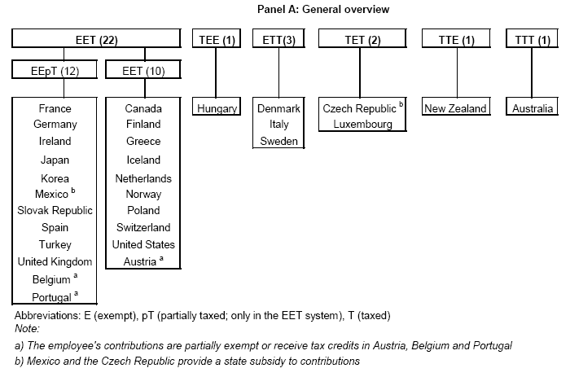
8. Taxation

Slide 13
8. Taxation
E T T
MODEL
Exemption of contribution
Taxation of returns (12,5% government bonds, 20% other)
Taxation of provisions
Tax incentives for private pension funds

Slide 14
Membership 1999-2017
Years | Collective PFs | Open PFs | Pre Existing PFs | "New" Insurance contract | "Old" Insurance contract | Total
1999 | 701,127 | 136,305 | 573,256 | - | - | 1,410,688
2000 | 877,523 | 223,032 | 591,555 | - | - | 1,692,110
2001 | 984,567 | 287,251 | 687,482 | - | 201,108 | 2,160,408
2002 | 1,021,186 | 337,600 | 679,603 | - | 357,313 | 2,395,702
2003 | 1,042,381 | 364,604 | 671,474 | - | 508,757 | 2,587,216
2004 | 1,062,907 | 382,149 | 666,841 | - | 628,176 | 2,740,073
2005 | 1,155,168 | 407,022 | 657,117 | - | 744,023 | 2,963,330
2006 | 1,219,372 | 440,486 | 643,986 | - | 880,380 | 3,184,224
2007 | 1,988,639 | 747,264 | 680,746 | 486,017 | 703,400 | 4,560,164
2008 | 2,043,509 | 795,605 | 676,994 | 701,819 | 674,332 | 4,850,782
2009 | 2,040,150 | 820,385 | 673,039 | 893,547 | 654,376 | 5,055,284
2010 | 2,010,904 | 848,415 | 668,625 | 1,160,187 | 610,098 | 5,272,579
2011 | 1,994,280 | 881,311 | 664,731 | 1,451,995 | 573,336 | 5,536,554
2012 | 1,969,771 | 913,913 | 662,162 | 1,794,835 | 534,816 | 5,848,727
2013 | 1,950,552 | 984,584 | 654,537 | 2,134,038 | 505,110 | 6,203,673
2014 | 1,944,276 | 1,057,038 | 645,371 | 2,356,674 | 467,255 | 6,447,186
2015 | 2,419,103 | 1,150,132 | 645,612 | 2,600,790 | 433,753 | 7,234,858
2016 | 2,596,819 | 1,258,986 | 653,352 | 2,881,528 | 411,242 | 7,785,961
2017 | 2,804,633 | 1,374,205 | 643,341 | 3,104,209 | 390,311 | 8,298,969
Source: Covip annual report for the year 2017 (2018)

Slide 15
Membership 1999-2017
Million Members
Source: Covip annual report for the year 2017 (2018)

Slide 16
Membership 1999-2017
Different growth paths for occupational and personal schemes
Until 2007 Occupational FPs
After 2007 strong growth of Personal PFs
New insurance contracts is the scheme with more members (3,104,209)
At the end of 2017, 62% of members are enrolled in a personal FP
Recovery of occupational PFs thanks to «Collective bargaining mandatory membership» from 2015

Slide 17
Collective bargaining mandatory membership
Mandatory membership to the sectorial occupational Fp through collective bargaining
Small employer incentive
In place from 2015 (Prevedi)
Currently 9 contractual PFs involved
826,000 employees enrolled so far
Silenzio-Assenso not successful
Only 282,000 members from 2007

Slide 18
Collective bargaining mandatory membership
PFs | Members | Of which through collective bargaining mandatory membership (AV) | Of which through collective bargaining mandatory membership (PV)
PREVEDI (building sector) | 745,157 | 707,847 | 95.0%
PRIAMO (Public trasport - Bus) | 92,796 | 26,683 | 28.8%
COOPERLAVORO (Cooperatives) | 72,126 | 6,671 | 9.2%
EUROFER (National Railways) | 71,299 | 34,726 | 48.7%
SOLIDARIETA’ VENETO (Veneto region) | 70,133 | 16,142 | 23.0%
FONDAPI (Small-Mid Company) | 55,870 | 22,221 | 39.8%
BYBLOS (Paper&Publishing sector) | 36,274 | 5,524 | 15.2%
ASTRI (National Motorway) | 15,571 | 6,230 | 40.0%
PREVIAMBIENTE (Cleaning sector)* | - | - | -
*Not available yet, currently in place
Source: Covip annual report for the year 2017 (2018)

Slide 19
Participation rates
 | Effective members* | Participation rates
Members | 7,585,969 | 28.9%
Members who did at least one in payment in 2017 | 5,772,172 | 22.1%
promemoria: | 25,930,000
Italian workforce**
*Number of persons enrolled in PFs
**Istat survey on Italian Workforce
Source: Covip annual report for the year 2017 (2018)
Low participation rate (less than 1/3 of eligible employees) …
10 years after the current legislative framework coming into effect
Not very satisfactory in-deed!
Asimmetric membership
Age, gender, regions, dimension of the company, type of employment

Slide 20
Membership by age cohorts (% values)
Age cohorts | Contractual PFs | Open PFs | PE PFs | New Insurance contracts | Total
<25 | 2.2 | 8.8 | 1.2 | 4.9 | 4.3
25-34 | 12.6 | 12.9 | 6.2 | 15.6 | 13.1
35-44 | 26.6 | 23.5 | 21.5 | 24.5 | 24.7
45-54 | 35.1 | 30.6 | 35.6 | 28.6 | 31.7
55-64 | 22.1 | 20.5 | 30.0 | 22.0 | 22.5
65 and more | 1.4 | 3.6 | 5.6 | 4.3 | 3.8
Total | 100.0 | 100.0 | 100.0 | 100.0 | 100.0
Promemoria:
Median age | 46.0 | 44.3 | 49.5 | 45.2 | 45.9
Young emplyees outsiders but those who most need of pension fund coverage in the future: NDC, job market, gig economy…
Source: Covip annual report for the year 2017 (2018)

Slide 21
Membership by gender (% values)
Age cohorts | Members
 | Males | Females
<25 | 4.1 | 4.7
25-34 | 13.1 | 13.0
35-44 | 24.1 | 25.7
45-54 | 31.4 | 32.2
55-64 | 23.0 | 21.7
65 and more | 4.4 | 2.8
Total | 100.0 | 100.0
Promemoria:
Gender distribution | 62.3 | 37.7
Median age | 46.2 | 45.3
Source: Covip annual report for the year 2017 (2018)

Slide 22
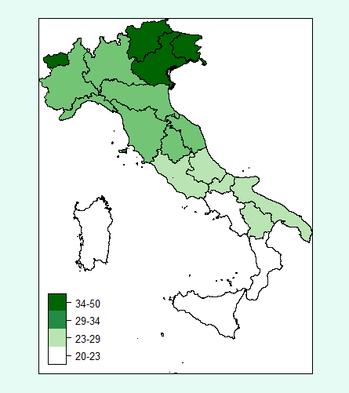
Membership by region
Source: Covip annual report for the year 2017 (2018)

Slide 23
Membership in summary
Insufficient participation rates
Less than 1/3 potential workforce
Asimmetries by
Age (young employees)
Gender
Dimension of the company
Public sector
How to strenghten membership?

Slide 24
Asset under management (Billion EUR.)
Years | Contractual PFs | Open PFs | PE PFs | New Insurance contracts | Old Insurance contracts | Total
1999 | 544 | 234 | 19,859 | - | - | 20,637
2000 | 1,190 | 552 | 21,269 | - | - | 23,011
2001 | 2,256 | 943 | 29,578 | - | 193 | 32,970
2002 | 3,264 | 1,230 | 29,531 | - | 617 | 34,642
2003 | 4,543 | 1,731 | 30,057 | - | 1,278 | 37,609
2004 | 5,881 | 2,230 | 30,617 | - | 2,150 | 40,878
2005 | 7,615 | 2,954 | 33,400 | - | 3,338 | 47,307
2006 | 9,257 | 3,527 | 34,246 | - | 4,546 | 51,576
2007 | 11,599 | 4,298 | 36,054 | 1,020 | 4,770 | 57,747
2008 | 14,092 | 4,663 | 35,906 | 1,958 | 4,667 | 61,302
2009 | 18,757 | 6,269 | 39,813 | 3,397 | 5,569 | 73,827
2010 | 22,384 | 7,533 | 42,007 | 5,229 | 5,980 | 83,167
2011 | 25,272 | 8,364 | 43,818 | 7,196 | 5,996 | 90,687
2012 | 30,174 | 10,078 | 47,972 | 9,813 | 6,273 | 104,363
2013 | 34,504 | 11,990 | 50,398 | 13,014 | 6,499 | 116,465
2014 | 39,644 | 13,980 | 54,033 | 16,369 | 6,850 | 130,941
2015 | 42,546 | 15,430 | 55,299 | 20,056 | 6,950 | 140,351
2016 | 45,931 | 17,092 | 57,538 | 23,711 | 6,931 | 151,278
2017 | 49,456 | 19,145 | 58,996 | 27,644 | 6,978 | 162,299
Source: Covip annual report for the year 2017 (2018)

Slide 25
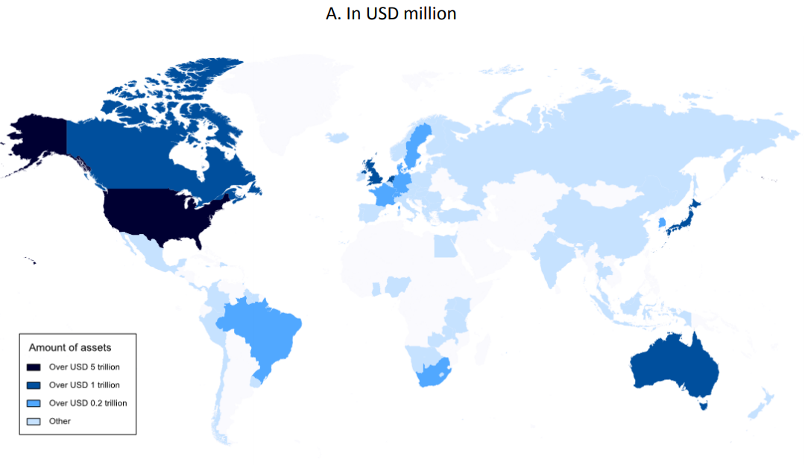
Asset under management (2016)
Italy: 165 billion USD
PR China: 159 billion USD
Source: OECD Pension Market in Focus 2017

Slide 26
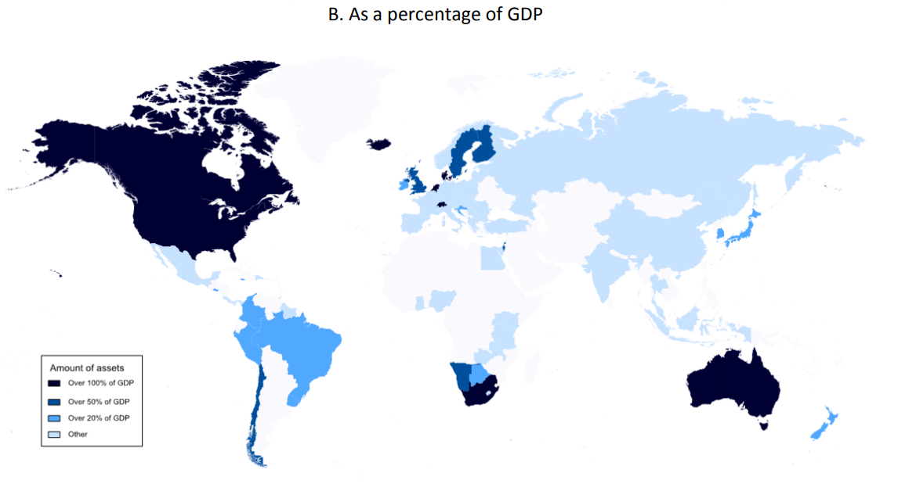
Asset under management (2016)
Italy: 9.4%
PR China: 1,5%
Source: OECD Pension Market in Focus 2017

Slide 27
Portfolio of PFs
Investment is regulated by low
Basically no more quantitative limits, PFs may invest in almost all financial activities, provided that it has an adequate risk management system
Role of Covip
Some quantitative limits still apply:
direct investment in real estate within 20% of AUM, only for pre-existing PFs
No direct investment in real estate for contractual PFs, open PFs and PIP
Investment in AIF: only 20% of AUM of PFs and 25% of AIF

Slide 28
Portfolio of PFs (billion EUR. and % values – 2017)
 |  | Contractual PFs |  | Open PFs |  | PE PFs** |  | New Insurance Contracts |  | Total
 |  | Bil. EUR. | % Val. | Bil. EUR. | % Val. | Bil. EUR. | % Val. | Bil. EUR. | % Val. | Bil. EUR. | % Val.
Cash |  | 3,459 | 7.0 | 2,333 | 12.2 | 2,303 | 7.3 | 1,182 | 4.2 | 9,278 | 7.2
Sovereign Bond |  | 22,569 | 45.6 | 7,088 | 37.0 | 9,490 | 29.9 | 14,059 | 50.5 | 53,272 | 41.5
of which: ITA |  | 9,536 | 19.3 | 4,362 | 22.8 | 4,558 | 14.4 | 10,560 | 37.9 | 29,079 | 22.7
Other fixed income |  | 8,669 | 17.5 | 1,211 | 6.3 | 4,595 | 14.5 | 6,767 | 24.3 | 21,251 | 16.6
of which: ITA |  | 705 | 1.4 | 183 | 1.0 | 443 | 1.4 | 1,344 | 4.8 | 2,676 | 2.1
Equity |  | 10,579 | 21.4 | 3,780 | 19.7 | 5,569 | 17.6 | 2,744 | 9.9 | 22,672 | 17.7
of which: ITA |  | 459 | 0.9 | 279 | 1.5 | 539 | 1.7 | 172 | 0.6 | 1,449 | 1.1
Mutual Funds* |  | 4,224 | 8.5 | 4,727 | 24.7 | 6,801 | 21.5 | 2,763 | 9.9 | 18,517 | 14.4
of whitch RE AIF |  | 38 | .. | 3 | .. | 1,450 | 4.6 | 140 | 0.5 | 1,631 | 1.3
Real Estate |  | - | - | - | - | 2,048 | 6.5 | - | - | 2,047 | 1.6
Other |  | -44 | -0.1 | 30 | .. | 886 | 2.8 | 330 | 1.2 | 1,181 | 0.9
Total |  | 49,456 | 100.0 | 19,145 | 100.0 | 31,692 | 100.0 | 27,845 | 100.0 | 128,218 | 100.0
of which ITA securities |  | 10,700 | 21.6 | 4,824 | 25.2 | 5,540 | 17.5 | 12,076 | 43.3 | 33,204 | 25.9
Promemoria
Median equity exposure |  |  | 25.3 |  | 40.5 |  | 22.0 |  | 18.8 |  | 25.3
*It takes into account both Ucits and AI mutual funds
**It does not take into account reserves on insurance contracts
Source: Covip annual report for the year 2017 (2018)

Slide 29
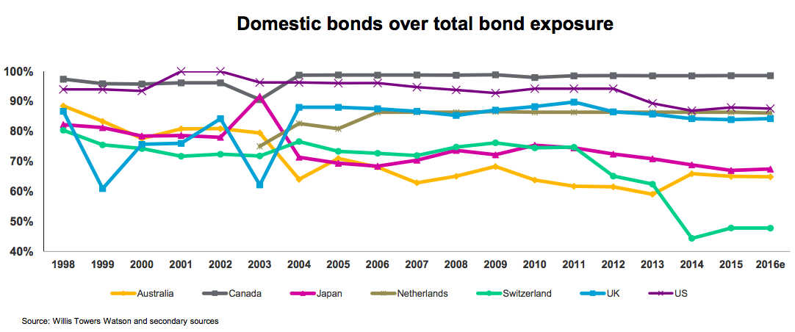
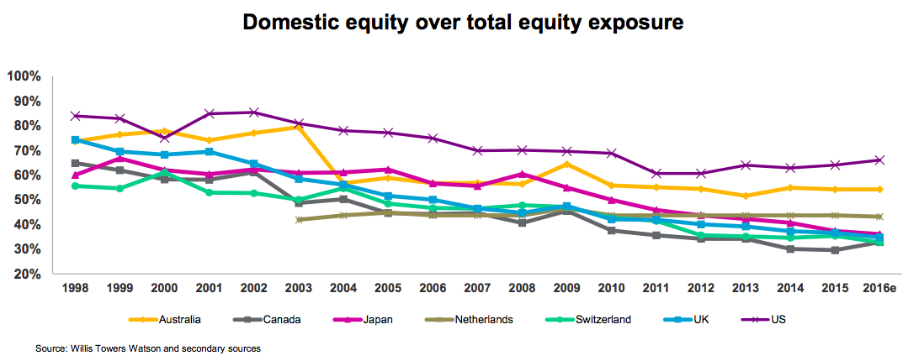
Home bias of portfolios
Italy= 43%
Italy= 6%

Slide 30
Portfolio of PFs: some issues
Only 26% of AUM is allocated in Italian assets (33 billion EUR.)
… mainly in government bonds (53 billion EUR. 23%)
Italian corporate bonds 2%
Investment in equity still limited: only 18%
Basically allocated outside Italy (US and Europe)
Negligable investment in Italian equity 1%
Alternative investments (PE, VC, infrastructure, RE, PD) still not widespread

Slide 31
Portfolio of PFs: some issues
Weak home bias for Investments of Italian PFs compared to other developed countries
The contribution of PFs to Italian economy in terms of investments still negligeble
Why?
Demand of financing side
Structure of the economy (small company, family firms, reluctance to go public and strong dependency from banks for financial needs, market of PE, VC, still thin)
Supply of financial instruments side:
Costs
Lack of disclosure and transparency
Structure of pension funds

Slide 32
Net returns (% values - 1999-2017)
Years | Contractual PFs | Open PFs | New Insurance Contracts | Old Insurance Contracts | TFR
1999 | - | 24.0 | - | - | 3.1
2000 | 3.5 | 2.9 | - | - | 3.5
2001 | -0.5 | -5.6 | - | - | 2.9
2002 | -3.4 | -13.1 | - | - | 3.1
2003 | 5.0 | 5.7 | - | - | 2.8
2004 | 4.6 | 4.3 | - | - | 2.5
2005 | 7.5 | 11.5 | - | - | 2.6
2006 | 3.8 | 2.4 | - | - | 2.4
2007 | 2.1 | -0.4 | - | - | 3.1
2008 | -6.3 | -14.0 | 3.1 | -21.9 | 2.7
2009 | 8.5 | 11.3 | 3.1 | 14.5 | 2.0
2010 | 3.0 | 4.2 | 3.2 | 4.7 | 2.6
2011 | 0.1 | -2.4 | 3.2 | -5.2 | 3.5
2012 | 8.2 | 9.1 | 3.3 | 7.9 | 2.9
2013 | 5.4 | 8.1 | 3.2 | 10.9 | 1.7
2014 | 7.3 | 7.5 | 2.9 | 6.8 | 1.3
2015 | 2.7 | 3.0 | 2.5 | 3.2 | 1.2
2016 | 2.7 | 2.2 | 2.1 | 3.6 | 1.5
2017 | 2.6 | 3.3 | 1.9 | 2.2 | 1.7
Source: Covip annual report for the year 2017 (2018)

Slide 33
Costs of PFs – Indicatore Sintetico di Costo (ISC)
Type of investment line | Indicatore Sintetico di Costo
 |  | 2 Years | 5 Years | 10 Years | 35 Years
 | Contractual PFs | 1.1 | 0.6 | 0.5 | 0.3
Guaranteed | Open PFs | 2.3 | 1.4 | 1.2 | 1.1
 | New Insurance Contracts | 3.7 | 2.4 | 1.9 | 1.4
 | Contractual PFs | 1.1 | 0.6 | 0.4 | 0.2
Fixed income | Open PFs | 1.9 | 1.3 | 1.1 | 0.9
 | New Insurance Contracts | 3.5 | 2.4 | 1.9 | 1.6
 | Contractual PFs | 1.0 | 0.5 | 0.4 | 0.2
Balanced | Open PFs | 2.4 | 1.6 | 1.4 | 1.3
 | New Insurance Contracts | 3.6 | 2.6 | 2.2 | 1.9
 | Contractual PFs | 1.2 | 0.6 | 0.4 | 0.2
Equity | Open PFs | 2.8 | 1.9 | 1.7 | 1.6
 | New Insurance Contracts | 4.5 | 3.2 | 2.7 | 2.3
ISC: measure of the impact of costs during accumulation phase on pots. It is based on Covip rules which are equal for all types of PFs. It is computed only at 2, 5, 10 and 35 years and it is based on an annual contribution of 2,500€ and a net year return of 4%

Slide 34
Investments choices of members* (% values)
Type of line investment | Contractual PFs | Open PFs | PE PFs | New Insurance contracts | Total
Guaranteed | 23.8 | 20.7 | 43.7 | 71.1 | 43.8
Fixed income | 18.0 | 11.5 | 16.4 | 3.8 | 12.3
Balanced | 56.6 | 52.6 | 36.7 | 11.7 | 37.6
Equity | 1.6 | 15.5 | 3.2 | 7.4 | 6.3
Total | 100 | 100 | 100 | 100 | 100
*Guaranteed: lines with a guaranteed return
*Fixed income: equity investments under 30%
*Balanced: equity investments equal or above 30% and up to 50%
*Equity: equity investments above 50%
Investment behaviour of members strongly conservative.
44% of members has joined a guaranteed line!
Source: Covip annual report for the year 2017 (2018)

Slide 35
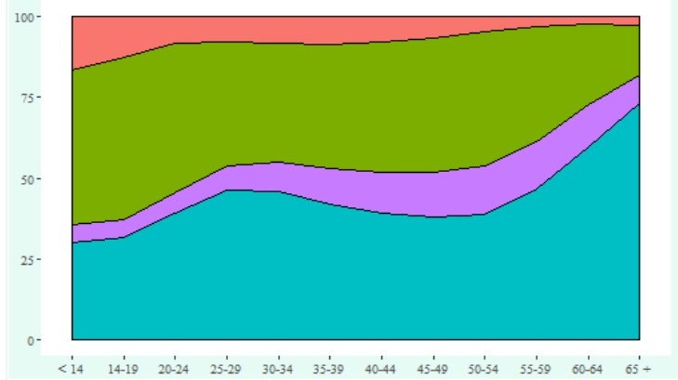
Investments choices of members* by age cohort
Equity lines
Balanced lines
Fixed income lines
Guaranteed lines
Source: Covip annual report for the year 2017 (2018)

Slide 36
Investment choices of members: some issues
Some concerns on investments choices
Guaranteed lines unsuitable for young members but highly appreciated:
poor returns, high cost
risk of a final pot lower than needed
Room for systems to help investment choices
data target
life cycle
…but still a niche

